Slide 1
Intro to Algorithms and Data Structures
INFO 3135
Course Introduction
Pseudo Code
Review of pointers

Slide 2
Course/Lecture Format
Each week:
Lecture + interactive* code examples
I’ll record and post later as a courtesy – you are expected to be in class, though
There are four (4) sections – I’m teaching one of them
Profs. Maaroof, Haworth, and Manning are teaching the other 3
We’ll try to keep them in sync, but we’re 3 different people, right? (i.e. you can’t just “sit in” on other sections)
Office hours:
For now, they are:
Wednesdays from “12:00” to “3:00” (between my morning and afternoon classes)
Tuesdays from 11:00 to 12:00 (after my morning class)
* “interactive” in that I’ll show you things and you can follow along “within reason”; if you missed anything, please look at the video later – i.e. I’m not waiting for super slow typers to “catch up”.

Slide 3
Marks?
See course plan
There’s a “live” version on github (we miss a couple Mondays and I’ll link that to FOL)
Assume due dates are the ones on FOL
Usually a small quiz/assignment each week
Not worth much, intention is to direct/focus on what we’ve done
Prepare for projects/exams
Projects: 2 large ones
Exams: A mid-term (in class) and final (in exam week)

Slide 4
Who am I?
Michael Feeney
G3001
mfeeney@fanshawec.ca
(mfeeney@fanshaweonline.ca goes to above address)

Slide 5
Where’s the stuff?
On Fanshawe online
Also on github: https://github.com/FeeneyCodes/INFO3135Fall2025
Do this only once:
“git clone https://github.com/FeeneyCodes/INFO3135Fall2025.git”
Do this all the time:
Right-click on your repo
In the console/bash: “git pull”

Slide 6
Lectures and Labs and homework
Discuss concepts
Learn specific data structures and algorithms with examples
We will do some coding during the lecture to help in understanding
Labs – we practice what we learn in the lecture.
Implement certain data structures or algorithms
The result of your labs exercises will be used in your practical exams.
Homework will be comprised of completing your lab exercises.
There will not be enough time during your lab hour to complete everything your need to ensure full understanding. You must complete these labs outside of class when needed

Slide 7
Marks, etc.
Taken from the Course Outline (FOL, Resources, Course Outline):
Quizes (16%) (most weeks, approximately 8 of them)
Assignments (4%) (two, in class)
Projects (30%) (two)
Mid-term exam (20%)
Final exam (30%)

Slide 8
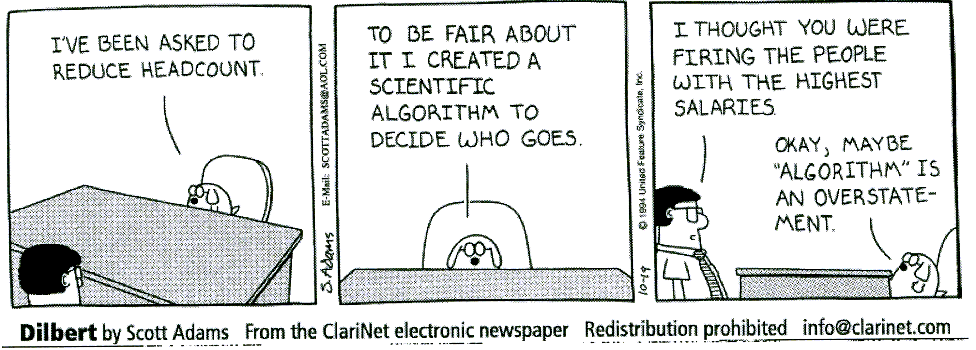
What you need to bring to class
Visual Studio
No textbook – we will provide internet resources
Inquisitiveness – be prepared to ask questions
Interest in learning
Desire to have fun

Slide 9
Data Structures and Algorithms
Some knowledge of algorithms and data structures is a necessity for any developer who wishes to become involved in many of the activities in software development such as:
Design
Implementation
Maintenance
R&D
There is a strong connection between data structures and algorithms.
This course looks at common data structures and their supporting algorithms with a focus on implementation.

Slide 10
Data
Data
Your code

Slide 11
Introduction
al·go·rithm
noun
a process or set of rules to be followed in calculations or other problem-solving operations, especially by a computer.
Origin
1890–95; variant of algorism, by association with Greek arithmós number.

Slide 12

Algorithms and Data structures
A TED talk on Algorithms
https://www.youtube.com/watch?time_continue=1&v=6hfOvs8pY1k

Slide 13
Algorithms
Every Algorithm must satisfy the following properties:
Input- There should be 0 or more inputs supplied externally to the algorithm.
Output- There should be at least 1 output obtained.
Definiteness- Every step of the algorithm should be clear and well defined.
Finiteness- The algorithm should have finite number of steps. It should finish and not go on forever.
Correctness- Every step of the algorithm must generate a correct output.

Slide 14
Algorithms
An algorithm is said to be efficient and fast, if it takes less time to execute and consumes less memory space. The performance of an algorithm is measured on the basis of following properties :
Time Complexity
a way to represent the amount of time required by the algorithm to run till its completion.
Space Complexity
the amount of memory space required by the algorithm, during the course of its execution.
Instruction Space: the space required to store the executable version of the program. This space is fixed, but varies depending upon the number of lines of code in the program.
Data Space: the space required to store all the constants and variables value.
Environment Space: the space required to store the environment information needed
while calculating the Space Complexity of any algorithm, we usually consider only Data Space and we neglect the Instruction Space and Environmental Stack

Slide 15
Complexity over time
In the past:
486/(Pentium, maybe): “CPU bound” (100 MHz)
Memory access took “0 time” (was not considered)
Now, it’s the complete opposite
CPUs are WAAAAAAAAY faster than memory
If you have a cache miss, it’s 500-1000 cycles
8-16 cores (aka “other CPUs”)
++x is faster than x++ (maybe the 386)
sqrt()

Slide 16
Data Structures
Data structure
Is a data organization, management, and storage format that enables efficient access and modification.
A data structure is a collection of data values, the relationships among them, and the functions or operations that can be applied to the data.
Different types of data structures are suited to different kinds of applications, and some are highly specialized to specific tasks. For example, relational databases commonly use B-tree indexes for data retrieval, while compiler implementations usually use hash tables to look up identifiers
Usually, efficient data structures are key to designing efficient algorithms. Some formal design methods and programming languages emphasize data structures, rather than algorithms, as the key organizing factor in software design
[Wikipedia]

Slide 17
Primitive Data Structures
The simplest data structures are primitive variables. They hold a single value, and beyond that, are of limited use. When many related values need to be stored, an array is used.
Another example of a basic data structure is an array, in which multiple data bits are coordinated into a group sharing a common label. This helps programs call these data bits or perform other work on the data set as a whole.
Another example is a stack, which places data units in relative hierarchies, allowing functions to work on the data in coordinated ways, such as pushing new data onto a stack, or popping data off the top of a stack

Slide 18
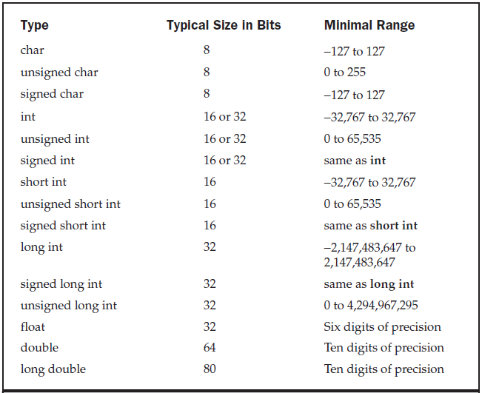
Primitive Data Structures C++
These primitive structures will be used to create more complex structures.
These almost always correspond to a CPU/GPUs “registers”

Slide 19
Non-primitive Data structures
The non-primitive data structures cannot be created without primitive data structures.
The Non-primitive data structures are further divided into the following categories:
Arrays - a homogeneous and contiguous collection of same data types. They have a static memory allocation technique
Files - A file is a collection of records. The file data structure is primarily used for managing large amounts of data which is not in the primary storage of the system.
Lists - lists support dynamic memory allocation.
Linear Lists – stacks, queues
The linear lists are those which have the elements stored in a sequential order.
Non-linear Lists – graphs, trees, hash based
non linear lists do not have elements stored in a certain manner.

Slide 20
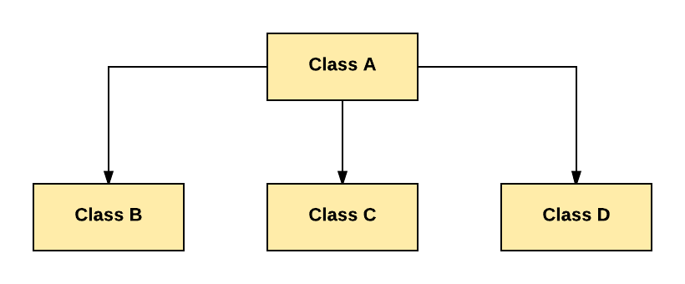
Derived Types and Data Structures
As C++ is an object oriented languages and supports the concept of classes we can also use these “derived” types to create data structures.
Using derived types will provide more flexibility and power in creating data structures but can also add complexity.

Slide 21
Derived Types and Data Structures
Giant Note: Object Oriented is Not:
The only way to “skin a cat”
Is *NOT* how computers actually work
It’s a helpful abstraction for us humble humans
May not be the best way, or even a good way
Mike Acton’s “3 big lies”:
https://cellperformance.beyond3d.com/articles/2008/03/three-big-lies.html
Software is the platform
Code should be designed around a model of the world
Code is more important than data

